Slide 1
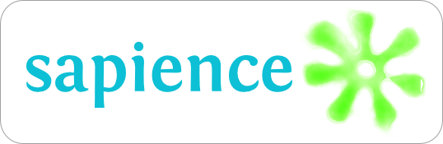
Semantic Annotations API
http://purl.org/net/sapience/docs
Lightweight Java API supporting the dynamic and standard- compliant injection of references to external shared vocabularies.

Slide 2
Semantic Annotations
Links in structured (bot not linked) data pointing to
  external dictionaries for non-functional properties, data quality aspects, trust, purpose, ...
  ontologies, thesauri, gazetteers capturing the data semantics
Injecting Semantic Annotations
  (potentially) ignores changes in underlying data models
  ensures standard-compliance
  Stream-based approach very efficient
  (should be) simple to semantically enable existing infrastructures and products

Slide 3
Examples
KML
<placemark>
<name> some river </name>
<ExtendedData>
<Data name="urn: … modelReference">
<value>http://sws.geonames.org/3020251/about.rdf</value>
</Data>
</ExtendedData>
<Point> ....
GML
<om:Observation>
<om:observedProperty
xlink:href=”urn:ogc:def:phenomenon:WaterStage”>
<om:Procedure
xlink:href=”http://.../rdf/Gauge04”
xlink:arcrole=”http://...:modelReference”>
...
GML Schema
<element name=”rivers”
type =”RiverType”
sawsdl:modelReference=”http://.../rdf/River”>
<complexType name=”banksType”>
…

Slide 4
Semantic Annotations Prosy (SAPR)
Http://semantic-proxy.appspot.com
Proxy-based solution for injecting links to external vocabularies into metadata of existing Web services.

Slide 5
Proxy for injecting links
Enables separation of concern (SoC)
  Linking not by Provider, but domain experts
  Context-aware links (one document, many sets of annotations)
Proxy
  Easy solution to add resources to LOD cloud
  Simple HTTP API
  Free Service (in the cloud)
  Support for WSDL, WFS, SOS, WPS, ...

Slide 6
Demo
Http://semantic-proxy.appspot.com

